Slide 1
Imperfections (corrected)
Eric Prebys, FNAL

Slide 2
Dipole Error (or Correction)
Recall our generic transfer matrix
If we use a dipole to introduce a small bend Θ at one point, it will in general propagate as
Remember this one forever

Slide 3
Example: Local Correction (“Three Bump”)
Consider a particle going down a beam line. By using a combination of three magnets, we can localize the beam motion to one area of the line
We require
Local Bumps are an extremely powerful tool in beam tuning!!

Slide 4
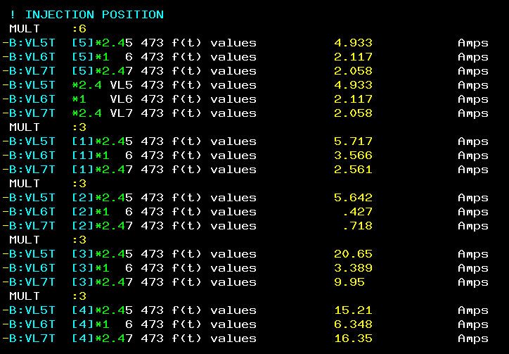
Controls Example
From Fermilab “Acnet” control system
The B:xxxx labels indicate individual trim magnet power supplies in the Fermilab Booster
Defining a “MULT: N” will group the N following magnet power supplies
Placing the mouse over them and turning a knob on the control panel will increment the individual currents according to the ratios shown in green

Slide 5
Closed Orbit Distortion (“cusp”)
We place a dipole at one point in a ring which bends the beam by an amount Θ.
The new equilibrium orbit will be defined by a trajectory which goes once around the ring, through the dipole, and then returns to its exact initial conditions. That is
Recall that we can express the transfer matrix for a complete revolution as

Slide 6
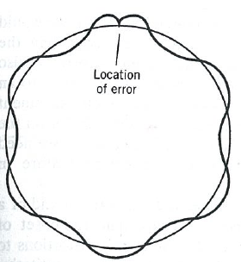
Plug this back in
We now propagate this around the ring

Slide 7
Quadrupole Errors
We can express the matrix for a complete revolution at a point as
If we add focusing quad at this point, we have
We calculate the trace to find the new tune
For small errors

Slide 8
Total Tune Shift
The focal length associated with a local anomalous gradient is
So the total tune shift is

